Slide 1
ADVANCED MACHINE LEARNING
Project Work on the
Fruits 360 Challenge

Slide 2
TABLE OF CONTENTS
01
02
03
PROBLEM STATEMENT
OUR SOLUTIONS
RESULTS
Describing the dataset
Transfer learning and custom models
Results and possible imporvements

Slide 3
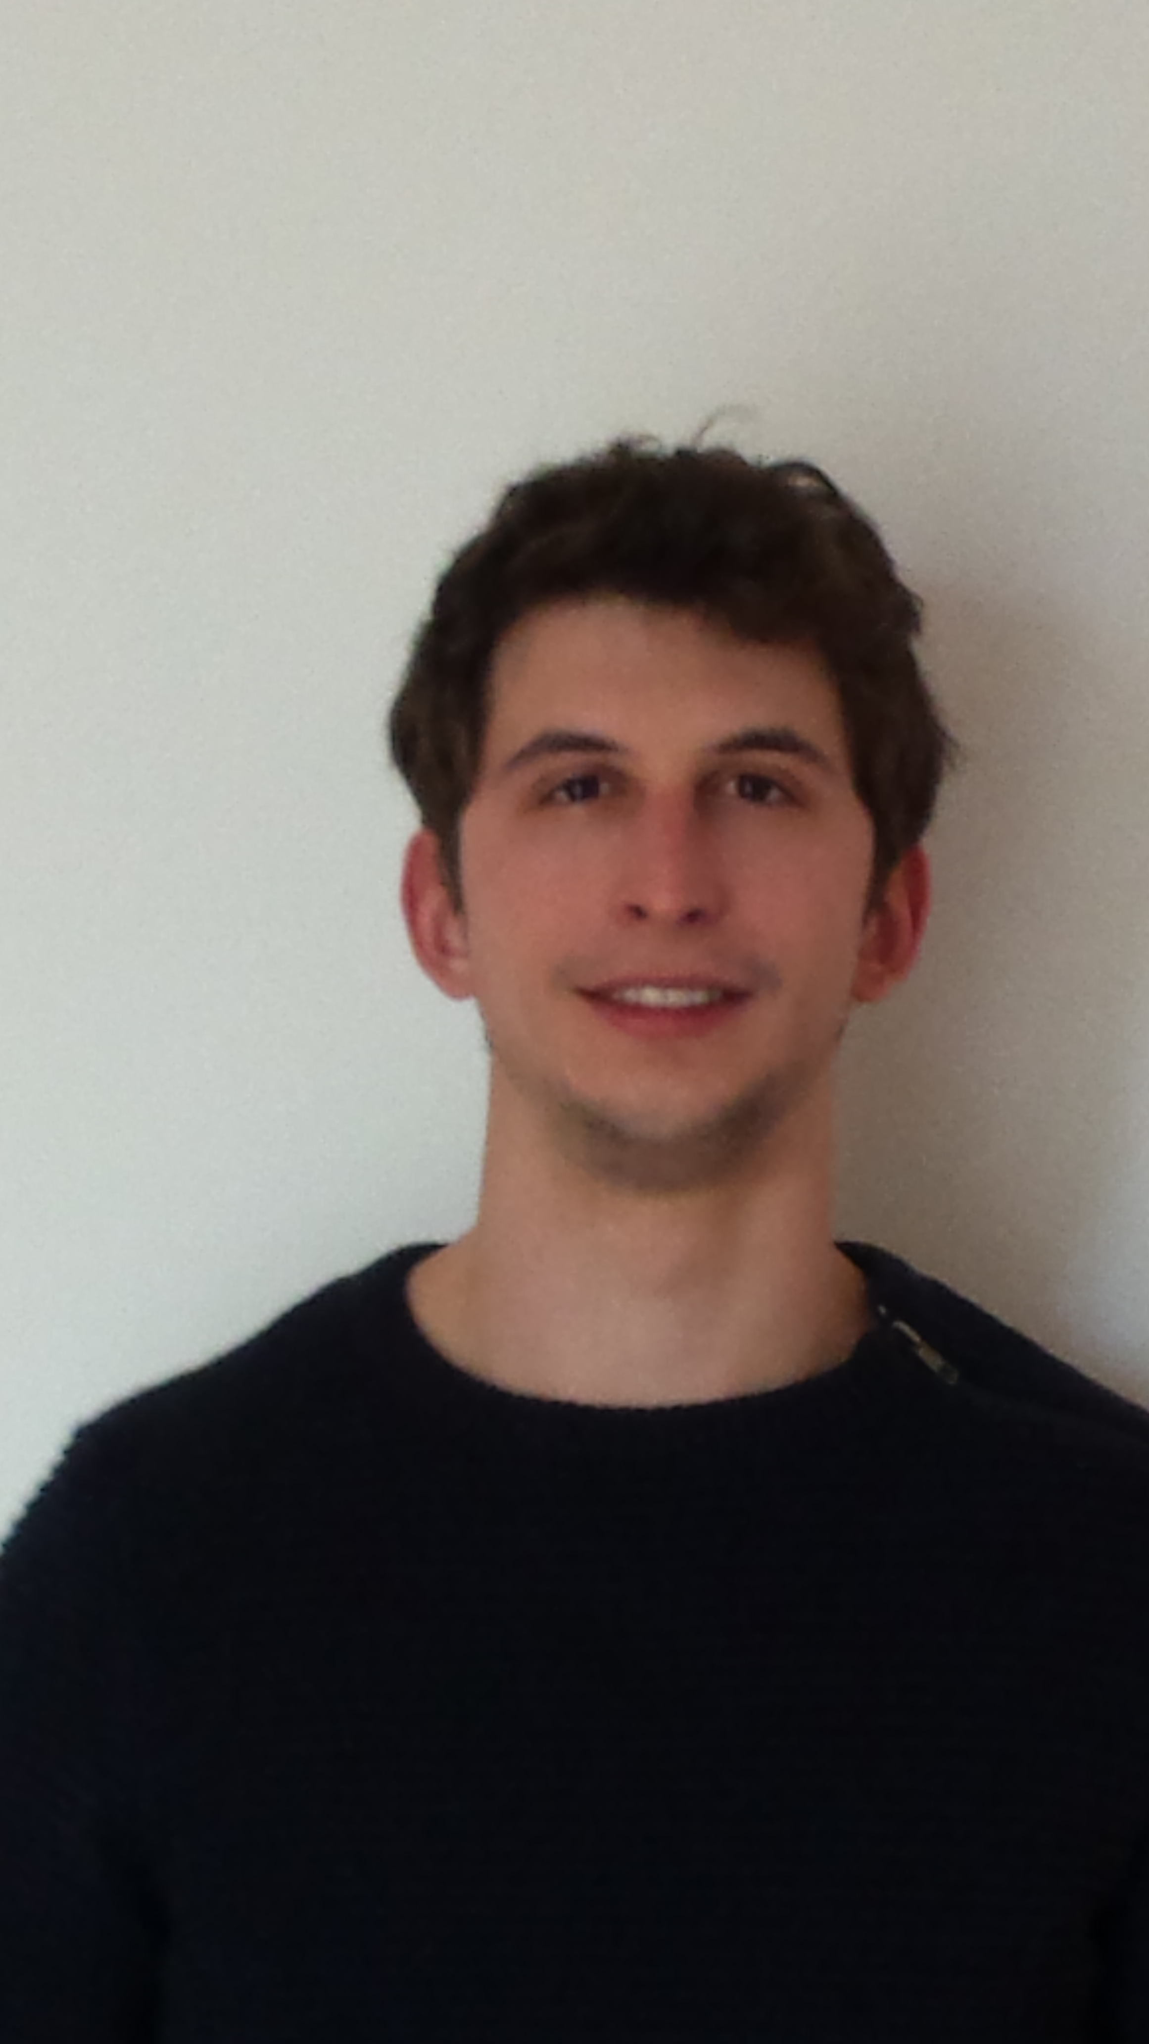
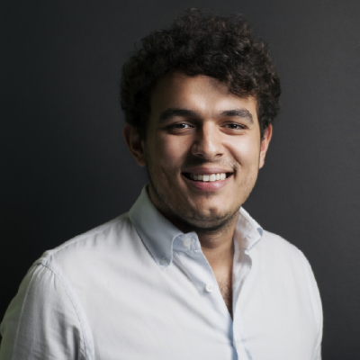
OUR TEAM
DAVIDE TONIOLO
OMAR GHETTI
Bachelor Degree in Physics
Currently student of Master Degree in Data Science
Bachelor Degree in Computer Science
Master degree student in Computer Science

Slide 4
01
PROBLEM STATEMENT

Slide 5
UNDERSTANDING THE PROBLEM
IMAGE CLASSIFICATION
COMPUTER VISON
Building a machine capable of working with image and video data.
Must categories non-structured data (images) into predefined categories

Slide 6
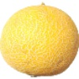
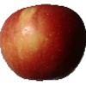
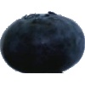
UNDERSTANDING THE PROBLEM
120 balanced
classes
KAGGLE
FRUITS 360 CHALLENGE
100x100 px images
with white background

Slide 7
OUR GOALS
HPO
TRANSFER LEARNING
BUILDING
Take state of the art CNN from ImageNet and explore their application to our data
Building a custom architecture and compare it to the transferred models
Make a principled choice of the hyperparameters and have a firmer ground for model comparison

Slide 8
SOLUTIONS
02

Slide 9
OUR PROCESS
EXPLORATION
CUSTOM MODEL
PHASE 02
PHASE 04
PHASE 01
PHASE 03
TRANSFER LEARNING
HPO
Coding the data exploration and model training pipeline
Building a small, simple and efficient CNN from scratch
Taking high performing competitors from ImageNet and training on our own task
Extracting the best performance out of our models

Slide 10
OUR SOLUTIONS
VGG-16
RESNET 50
INCPETION V3
CUSTOM
Smaller kernels
Skip connections
Network-in-network
Ad hoc

Slide 11
HPO
03

Slide 12
RESULTS
VGG-16
RESNET 50
INCEPTION V3
CUSTOM MODEL
Test Accuracy
85%
90%
95%
100%

Slide 13
WRAPPING UP

Slide 14
ENANCHEMENTS
KERAS TUNER
NAS
LCP
CODE REFACTORING
ON CUSTOM
FASTER HPO
Free the code form skopt’s bugs and perform better HPO on Inception and Custom
How many conv layers? Better with one or many pooling?
Learning curve prediciton would allow us to avoid spending time on bad configurations

Slide 15
THANKS

